Slide 1
Building Scalable Applications with Spring & Cassandra
@thecodealchemist

Slide 2

Agenda
What is Cassandra?
Why Spring + Cassandra?
Setting up Cassandra on Local
Setting up Spring Boot Project
Working with Spring + Cassandra

Slide 3
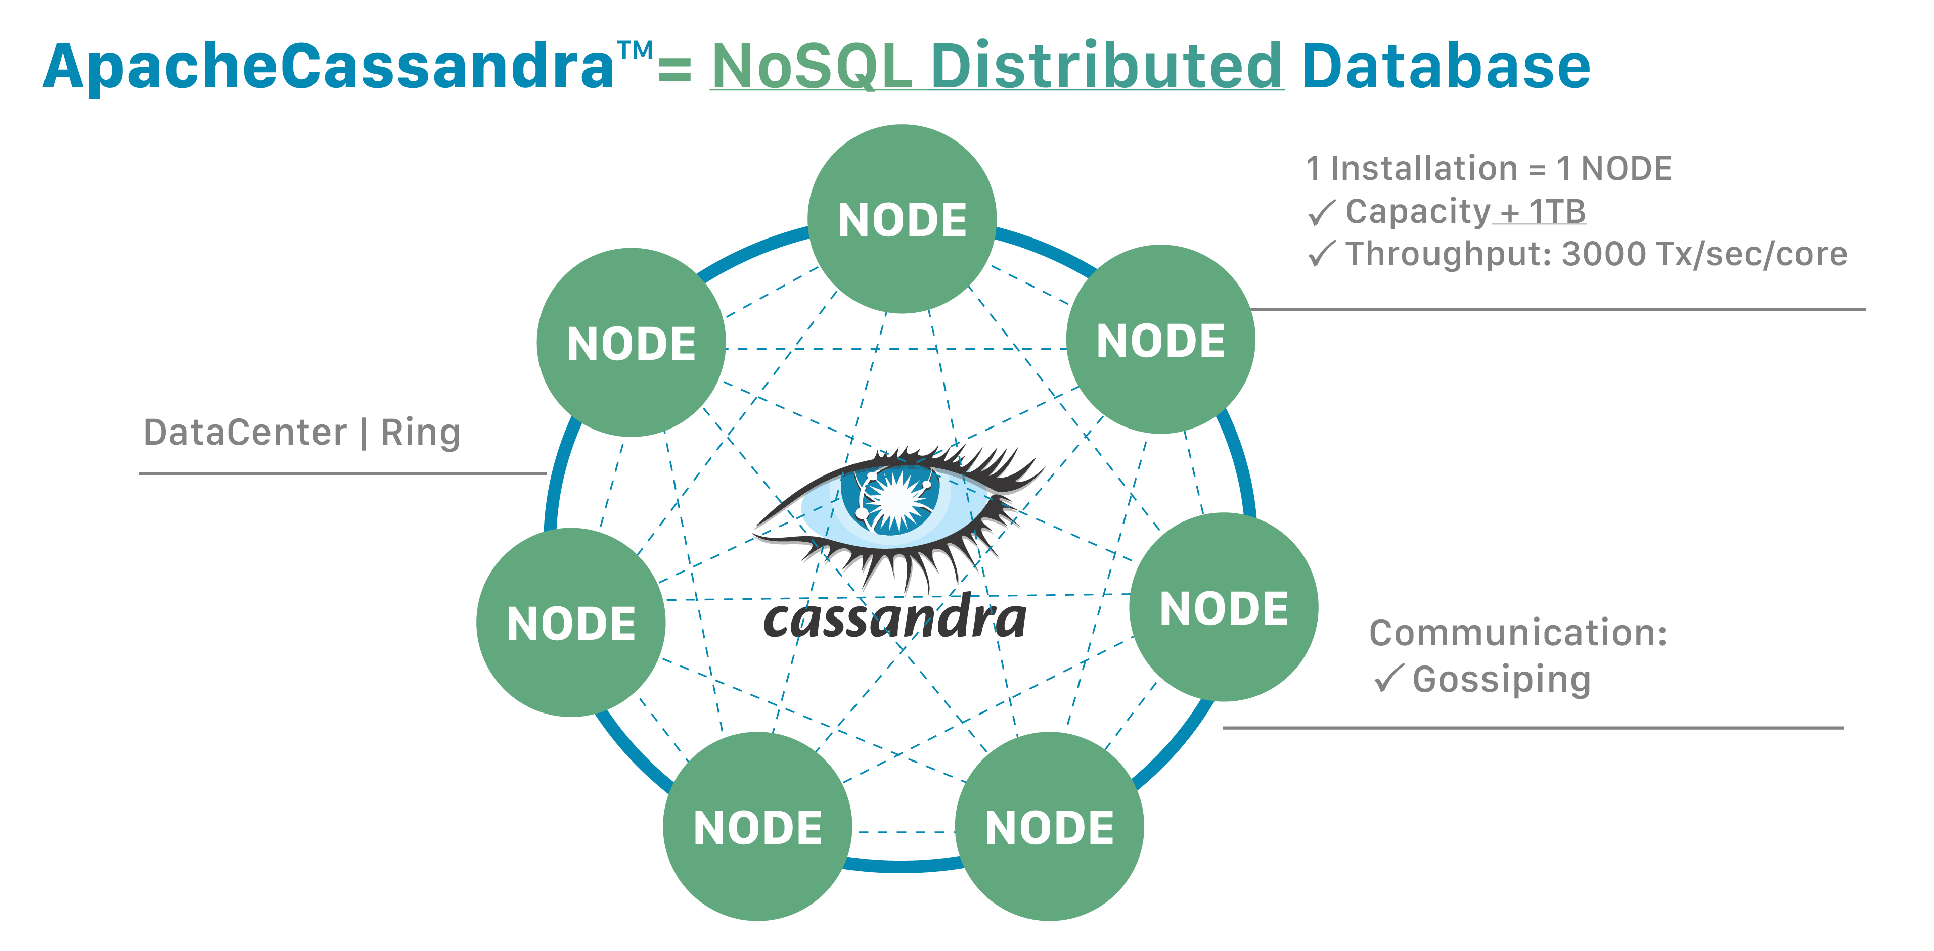
What is Cassandra?
Apache Cassandra is an open-source, distributed, decentralized, and highly scalable NoSQL database management system.
Initially developed at Facebook
Use Cases:
Time-Series Data and IoT Applications
Analytics and Big Data Solutions
Messaging and Chat Applications
Recommendation Engines

Slide 4
Key Features..
Distributed Architecture
Highly available
Horizontally scalable
Tuneable consistency

Slide 5
Data Model
Key Space
Column family aka Table
Primary Key
Partition Key
Clustering Columns

Slide 6
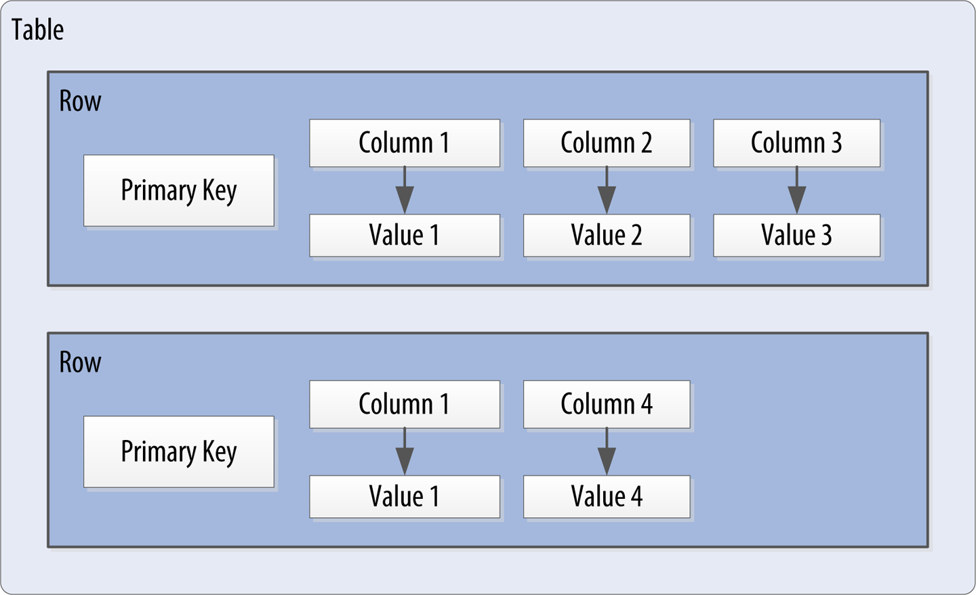
Data Model contd..

Slide 7
Why Spring + Cassandra?
Spring's powerful features make integration with Cassandra seamless.
Spring Data Cassandra
Integration library provided by Spring for Cassandra
Helps with data access and object mapping
Spring Boot
Simplifies application setup and configuration
Auto-configuration for Cassandra connection

